Slide 1
XML and JSON

Slide 2
What are XML and JSON?
XML stands for Extensible Markup Language and is a text-based markup language
JSON or JavaScript Object Notation is a lightweight text-based open standard designed for human-readable data interchange
Both are text format for storing and transporting data
Both are human- and machine-readable
Remember – XML and JSON do not do anything, they just show data that can be used by other languages

Slide 3
XML
XML tags identify the data and are used to store and organize the data, rather than specifying how to display it like HTML tags
There are three important characteristics of XML that make it useful:
XML is extensible − XML allows you to create your own self-descriptive tags, or language, that suits your application.
XML carries the data, does not present it − XML allows you to store the data irrespective of how it will be presented.
XML is a public standard − XML was developed by an organization called the World Wide Web Consortium (W3C) and is available as an open standard.

Slide 4
XML Usage
XML can work behind the scene to simplify the creation of HTML documents for large web sites
XML can be used to exchange the information between organizations and systems.
XML can be used for offloading and reloading of databases.
XML can be used to store and arrange the data, which can customize your data handling needs.
XML can easily be merged with style sheets to create almost any desired output.
Virtually, any type of data can be expressed as an XML document

Slide 5

XML
XML is a markup language that defines set of rules for encoding documents in a format that is both human-readable and machine-readable.
Markup is information added to a document that enhances its meaning in certain ways

Slide 6
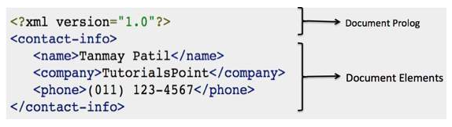
XML Documents
Document Prolog comes at the top of the document, before the root element. This section contains
Document Elements are the building blocks of XML. These divide the document into a hierarchy of sections, each serving a specific purpose.
Document will have filename extension .xml

Slide 7
XML let’s just practice a bit
Check more info here, and let’s make some XML in accordance with information we can find on: https://www.w3schools.com/xml/xml_elements.asp
XML by itself cannot do anything, but can store data so other languages can use it.
Here we covered only basics, feel free to read more

Slide 8
JSON
JSON or JavaScript Object Notation is a lightweight text-based open standard designed for human-readable data interchange.
Conventions used by JSON are known to programmers, which include C, C++, Java, Python, Perl, etc.
The filename extension is .json
Usage:
It is used while writing JavaScript based applications that includes browser extensions and websites.
JSON format is used for serializing and transmitting structured data over network connection
It is primarily used to transmit data between a server and web applications
Web services and APIs use JSON format to provide public data
It can be used with modern programming languages

Slide 9
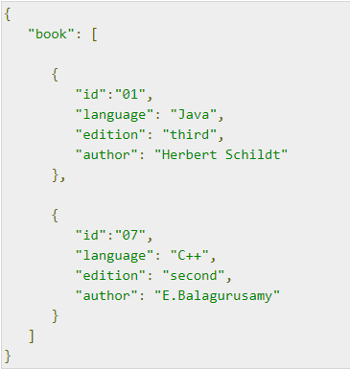
JSON
Easy to read and write
The following example shows how to use JSON to store information related to books based on their topic and edition:

Slide 10
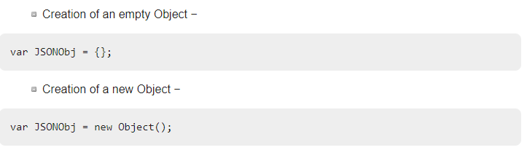
JSON
Datatypes are like in JS
JSON objects can be created with JavaScript

Slide 11
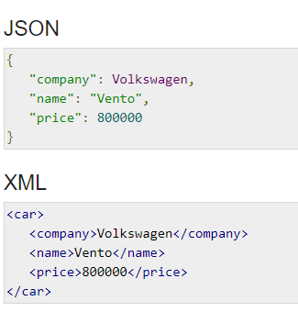
JSON vs XML
XML is more verbose than JSON, so it is faster to write JSON for programmers.
XML is used to describe the structured data, which doesn't include arrays whereas JSON include arrays.
JavaScript's eval method parses JSON.
When applied to JSON,
eval returns the described object.

Slide 12
Let’s experiment with JSON
Let’s write few json code examples using info from the website:
https://www.w3schools.com/js/js_json_datatypes.asp
Then let’s check the same object represented in JSON and XML:
https://www.w3schools.com/js/js_json_xml.asp

Slide 13
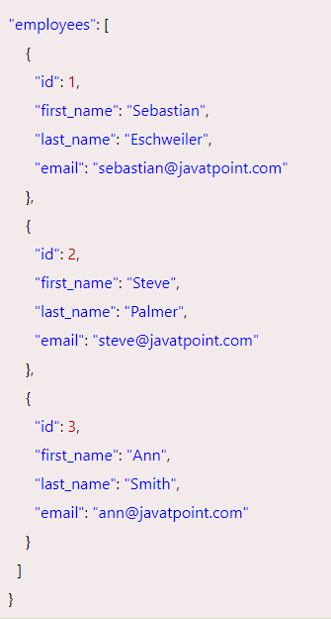
Coding Challenge 1
Create corresponding XML file for this example written in JSON:

Slide 14
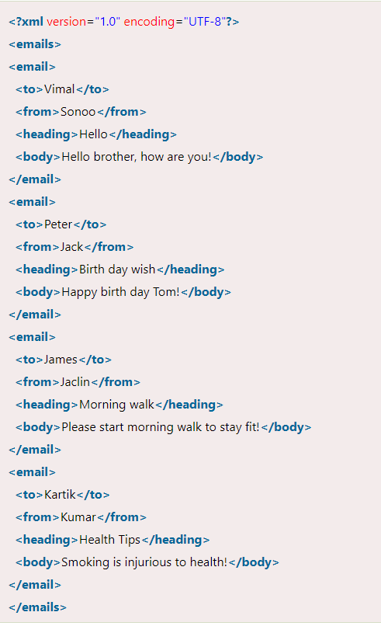
Coding Challenge 2
Create corresponding JSON code for the example written in xml

Slide 15
Some examples to check your knowledge
Check examples on the page:
https://json.org/example.html

